Slide 1

Fantastic Fantasy Films (FFF)
FROM RAGHAVENDRA ASHOK FOR INSAID

Slide 2

Problem Statement
In Hollywood, an average of 600 movies are produced/released per year - so 6000 movies were released between 2006 and 2016.
To understand the Trends in the current market scenario for the Production Company – Fantastic Fantasy Films, a Data Scientist was approached to provide inputs on a sample of the data.
Data has following features -
Thousand movies released between 2006 and 2016 were taken as sample
The IMDB ratings collected spanned between a low of 1 to a high of 9
The movies collected were from different genres/set of genres

Slide 3
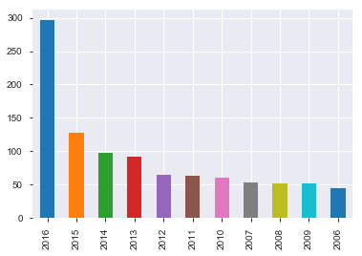
Movies Released Per Year
As we can see the majority of the movies were released in the year 2016
Notes:
The Project Name is Thousand Movies_Raghavendra Ashok.ipynb

Slide 4
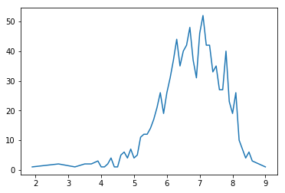
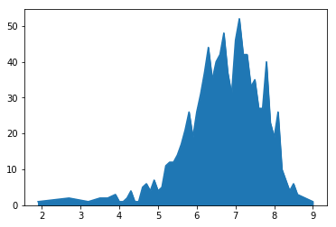
Ratings of Movies
As we can see most of the movie ratings, fall between the rating of 6.5 to 8. So typically any movie can be considered as 'Good' Movies if the rating is > 6.5
Notes:
The Project Name is Thousand Movies_Raghavendra Ashok.ipynb

Slide 5
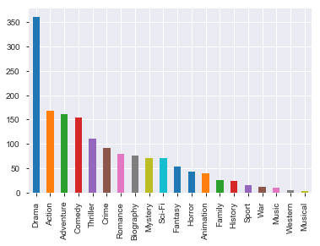
In Movies with Good Rating (>6.5), which Genre which has the highest movies releases
As you can see the movie Genre that is released the most is Drama. Followed by Action, Adventure, Comedy

Slide 6
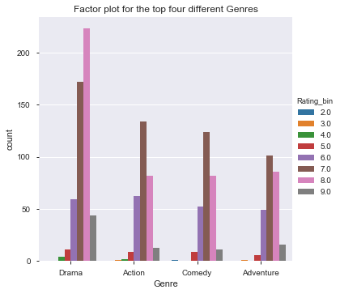
Out of the Top Four Genres,what is most likely Genre Combination to have good ratings?
Out of all top four Genres, a combination of Drama & Adventure has received Top Most ratings

Slide 7
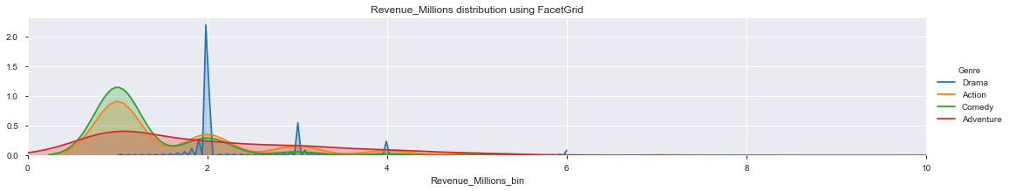
What is the relationship between the top four Genres & Revenue?
Since this database does not contain the 'cost of production' or 'investment' or 'budget', there is no way to find out the profit of each of the movies and so the genres.
Revenue does not indicate the profit so a high revenue movie does not indicate that a movie is successful and was profitable.
In fact, the highest revenue movies could have an higher 'cost of production' than its revenue leading it to be a disaster
In other words, the lowest revenue movies could have an lower 'cost of production' than its revenue leading it to a box office success.
So we will limit this analysis to the top 4 Genres only and not extend this to other Genres.

Slide 8
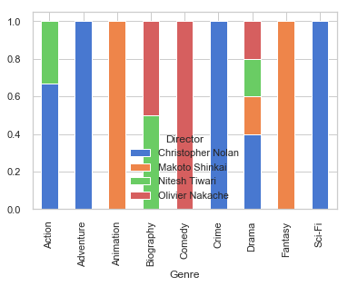
Who are the Top Best Directors with Great Ratings (Rating > 8.5) and their Genre Strengths?
The Top Four Directors with movie rating > 8.5 are
Christopher Nolan
Makoto Shinkai
Nitesh Tiwari
Olivier Nakache

Slide 9
Thank You

